Slide 1

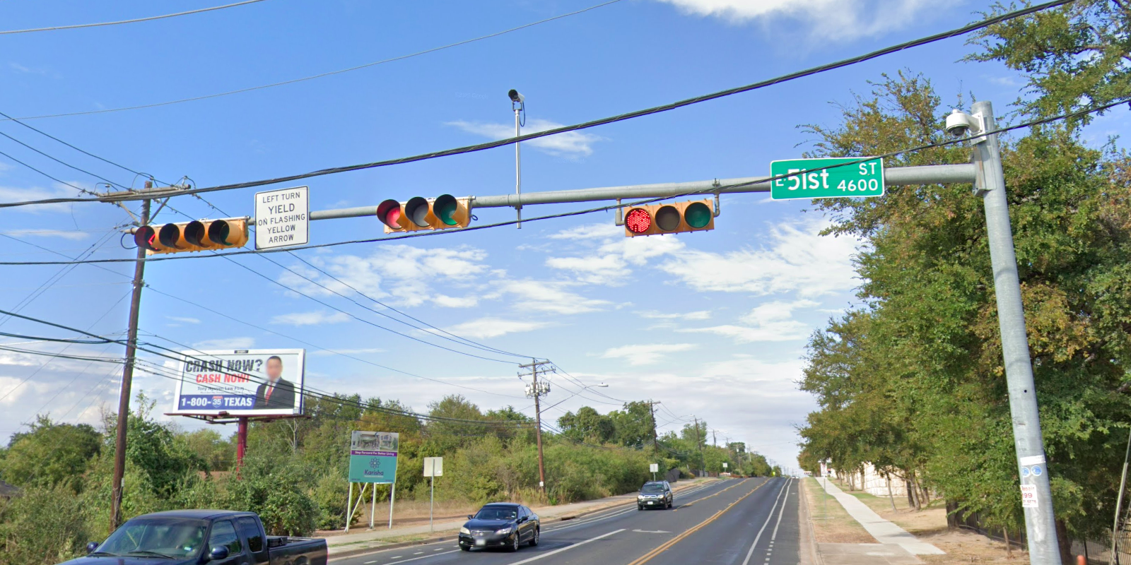
Austin Transportation Department Signs Work Orders
Created By: Susanne Gov Created Date: 2020-05-21 Location Name: SPRINGDALE RD / 51ST ST Intersection ID: 5164505 Cardinal Direction: N
Sign Type | Install/Remove
Left Turn Yield Flashing Yellow | Install
Street Name Sign | Install

Slide 2
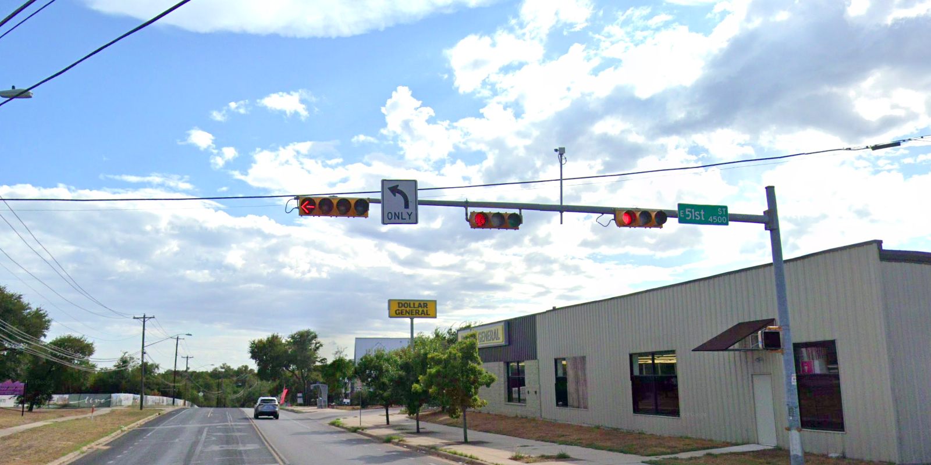
Austin Transportation Department Signs Work Orders
Created By: Susanne Gov Created Date: 2020-05-21 Location Name: SPRINGDALE RD / 51ST ST Intersection ID: 5164505 Cardinal Direction: S
Sign Type | Install/Remove
Street Name Sign | Install
Left Turn Arrow Only | Install

Slide 3
Austin Transportation Department Signs Work Orders
Created By: Susanne Gov Created Date: 2020-05-21 Location Name: SPRINGDALE RD / 51ST ST Intersection ID: 5164505 Cardinal Direction: E
Sign Type | Install/Remove
Left Turn Yield Flashing Yellow | Install
Street Name Sign | Install

Slide 4
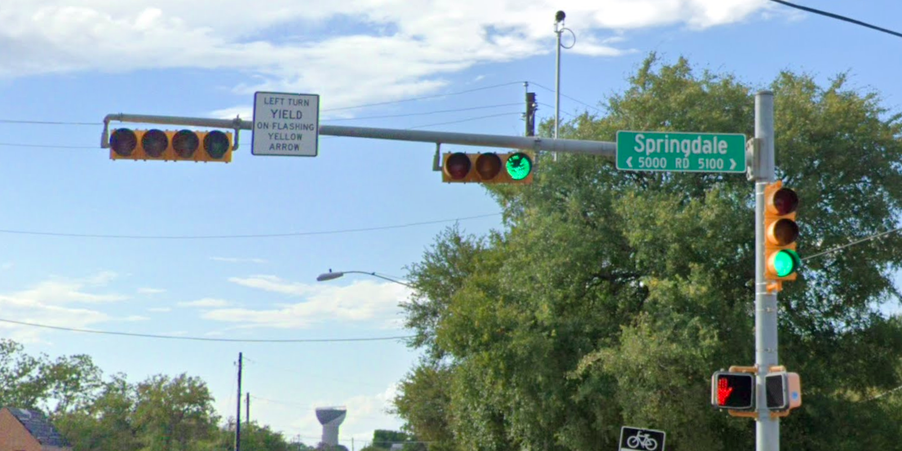
Austin Transportation Department Signs Work Orders
Created By: Susanne Gov Created Date: 2020-05-21 Location Name: SPRINGDALE RD / 51ST ST Intersection ID: 5164505 Cardinal Direction: W
Sign Type | Install/Remove
Left Turn Yield Flashing Yellow | Install
Street Name Sign | Install

